Slide 1
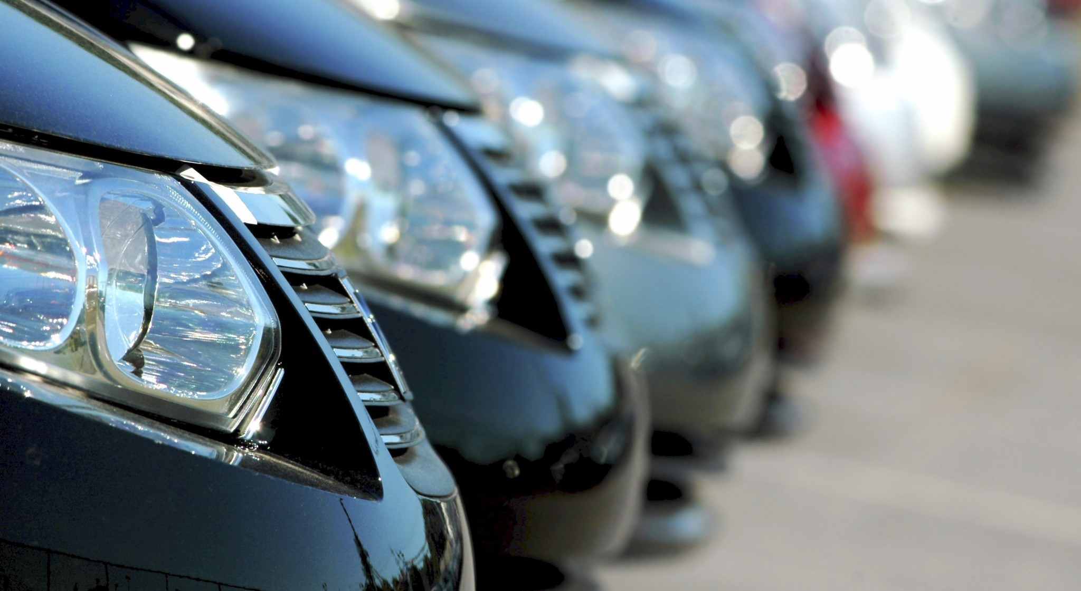
Title needed
By: Ronise Ball Atarah Buckins
Deonna Foster Renee Goeglein
Totianne Wade
This Photo by Unknown Author is licensed under CC BY-SA

Slide 2
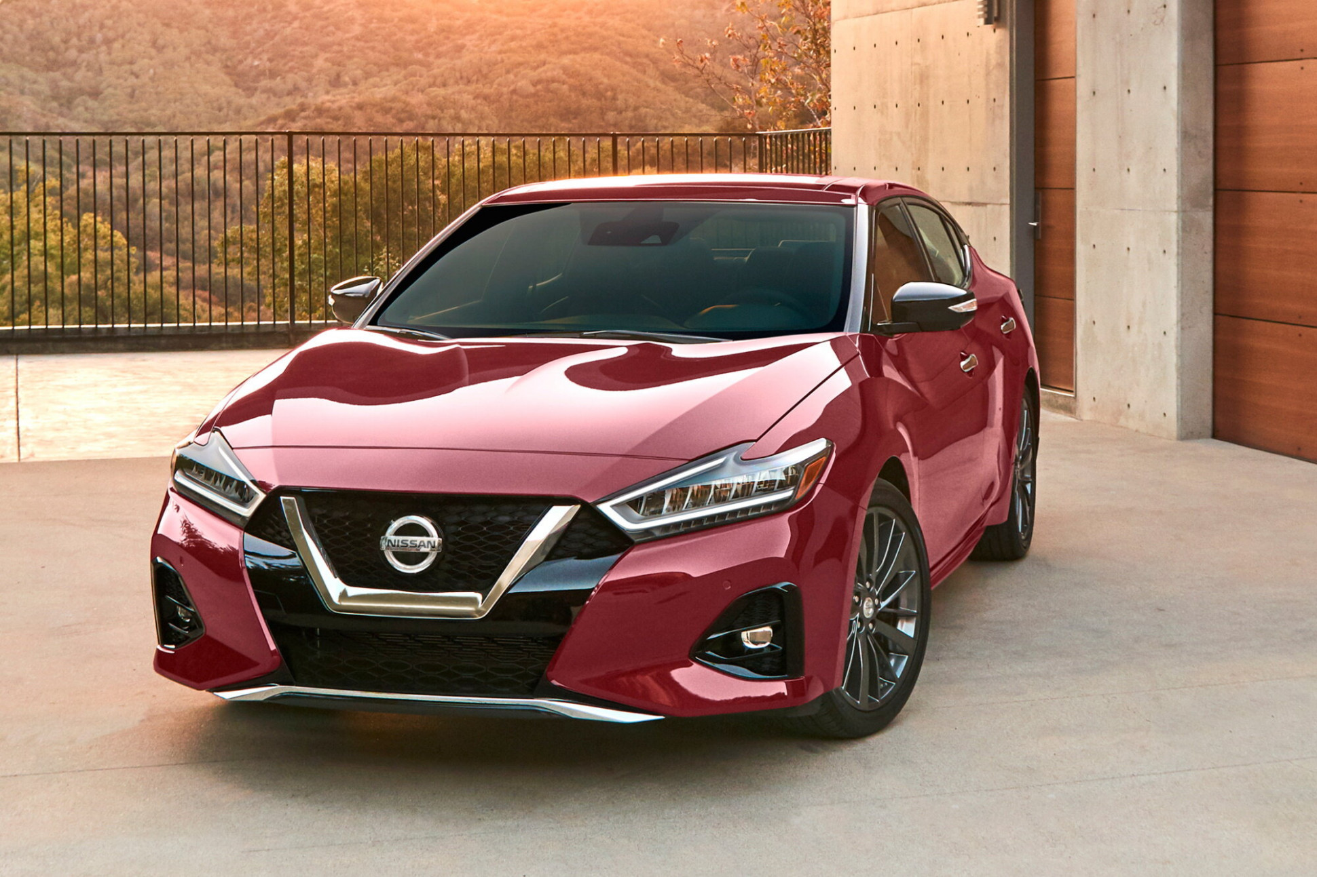
Table of contents
Group Introductions
Topic background
Data Wrangling and Methods
“Exploratory Analysis” and Results
Summary
Conclusion
Questions

Slide 3

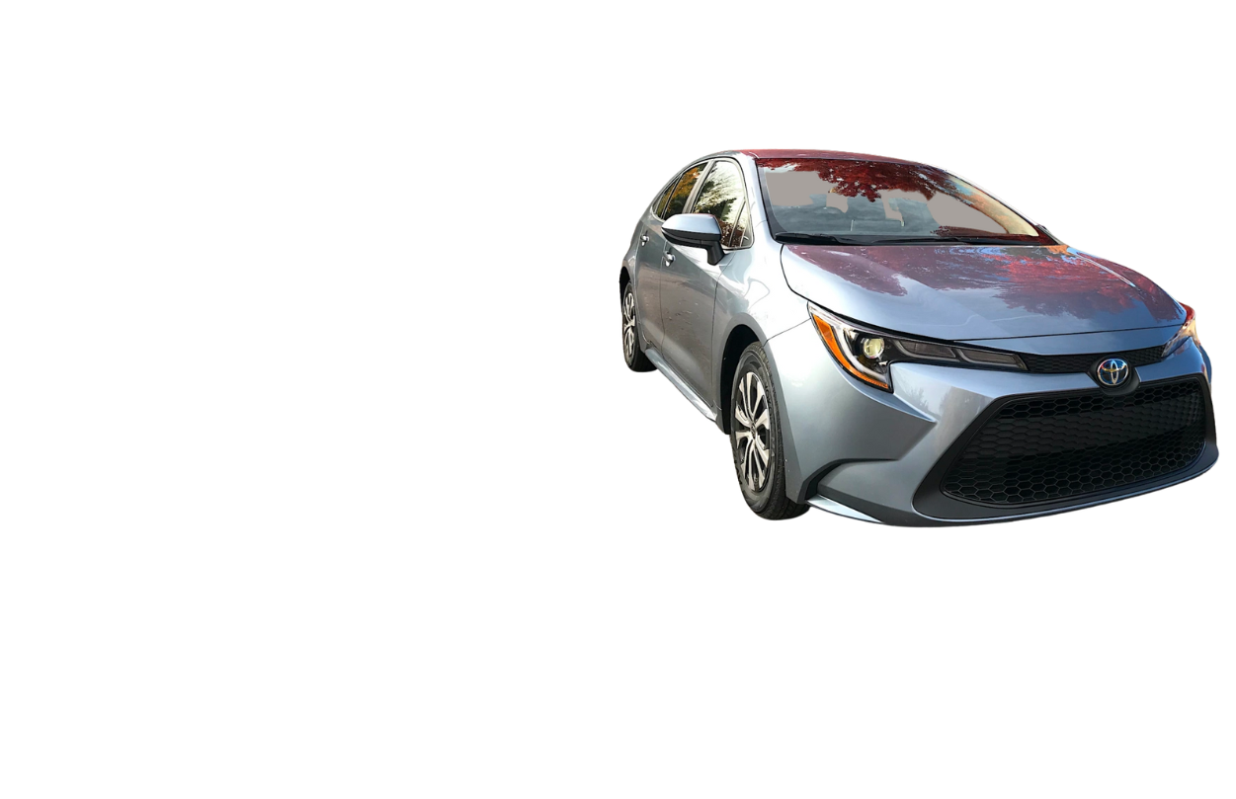
An “exploratory analysis” of Ronise Ball
Education:
Delaware State University
Bachelor of Science in Movement Science
Entity Academy-2022
Data Science certificate
Experiences:
Sales Development for Stealth Start Up
Pre-K Teacher for Chesterbrook Academy
Business Liaison for Research Triangle Institute
Small business owner
Coming from an extensive sales and digital marketing experience Ronise specializes in spotting patterns and problems , then delivering solutions.
This Photo by Unknown Author is licensed under CC BY-SA

Slide 4
An “exploratory analysis” of
Atarah Buckins

Slide 5
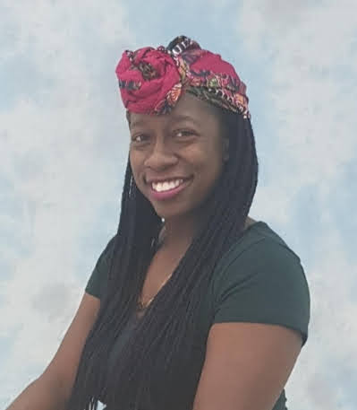
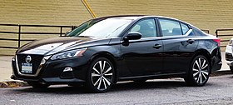
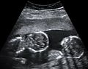
An “exploratory analysis” of Deonna Foster
Education:
Tennessee State University-2007
Bachelor of Science in Biological Sciences
Grand Canyon University-2018
Master of Science in Public Health (general)
Entity Academy-2022
Data Science certificate
Experiences:
2010-2012: Pre-K teacher for a private school in Atlanta, GA.
2013-2014: Bed rest; Birth of my twins; stay at home caregiver
2014-2019: Taught Pre-Kindergarten, Kindergarten, and 1st grade at an American International school in Kuwait
2020-current: Public Health Advisor at the Centers for Disease Control and Prevention in Atlanta, GA.
This Photo by Unknown Author is licensed under CC BY-SA

Slide 6
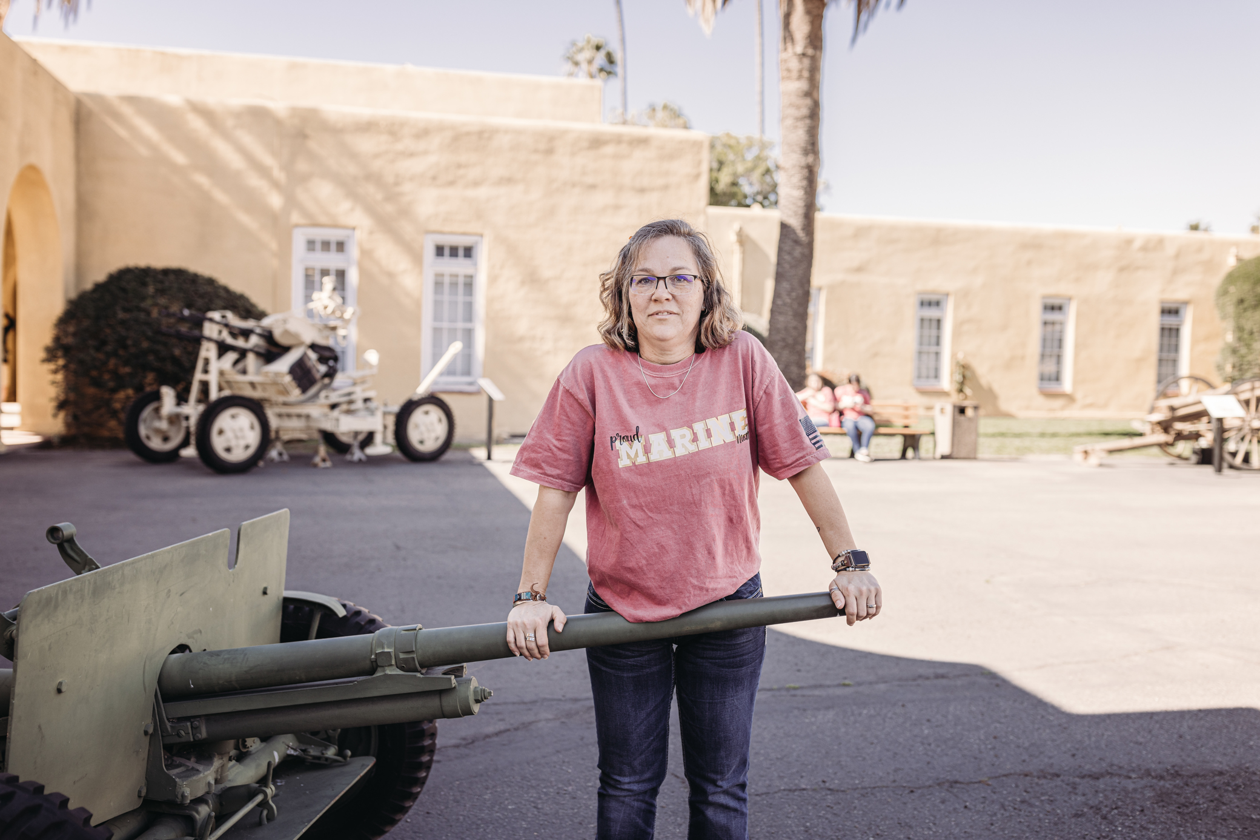
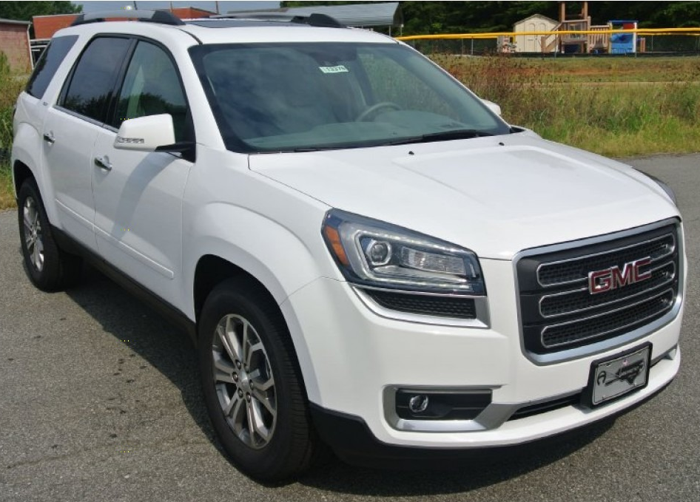
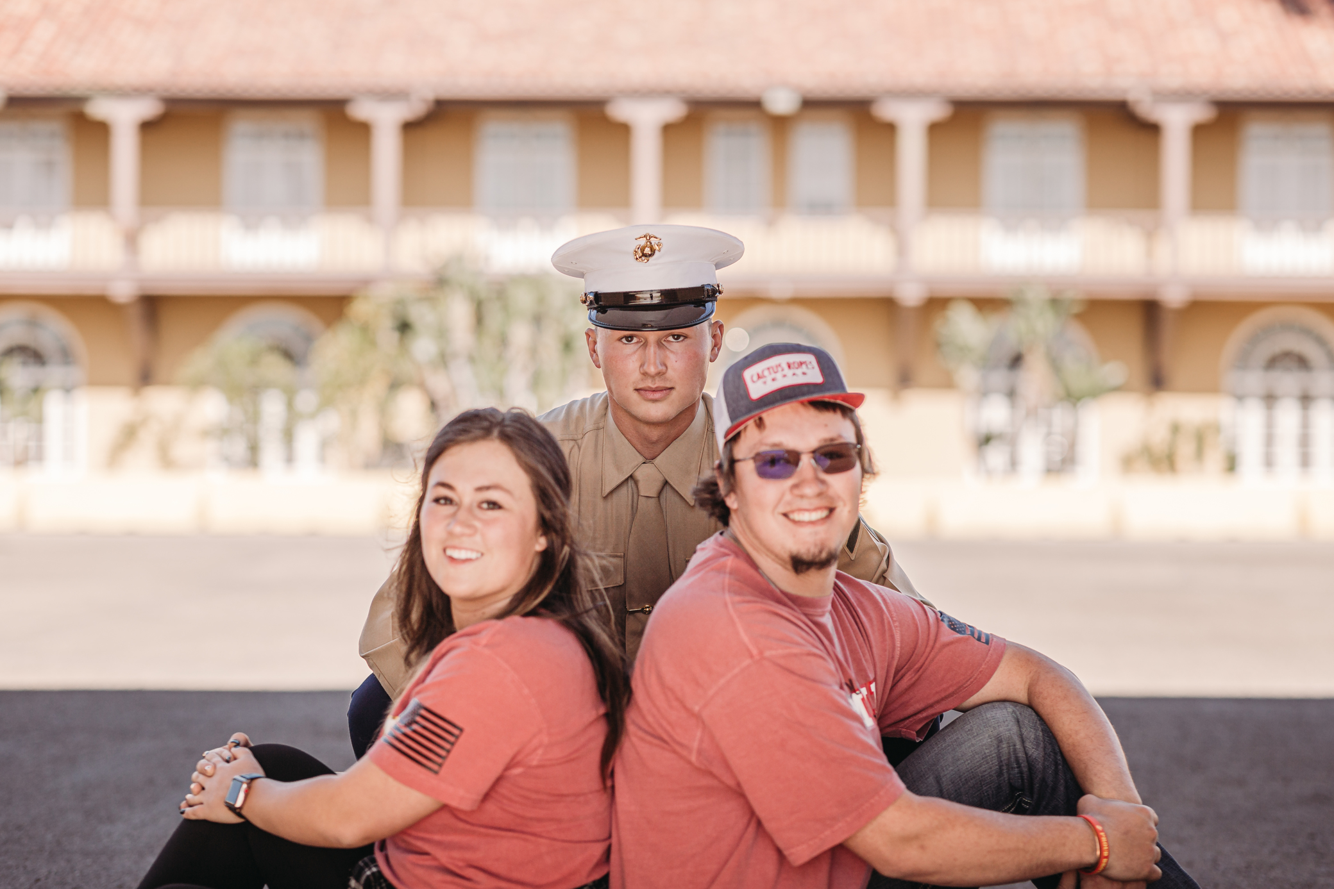
An “exploratory analysis” of
Renee Goeglein
Education
Entity Academy – 2022
Data Science Analysis
Experiences
Yuma County Pest Control District
Office Manger - 2007

Slide 7
An “exploratory analysis” of
Totianne Wade

Slide 8
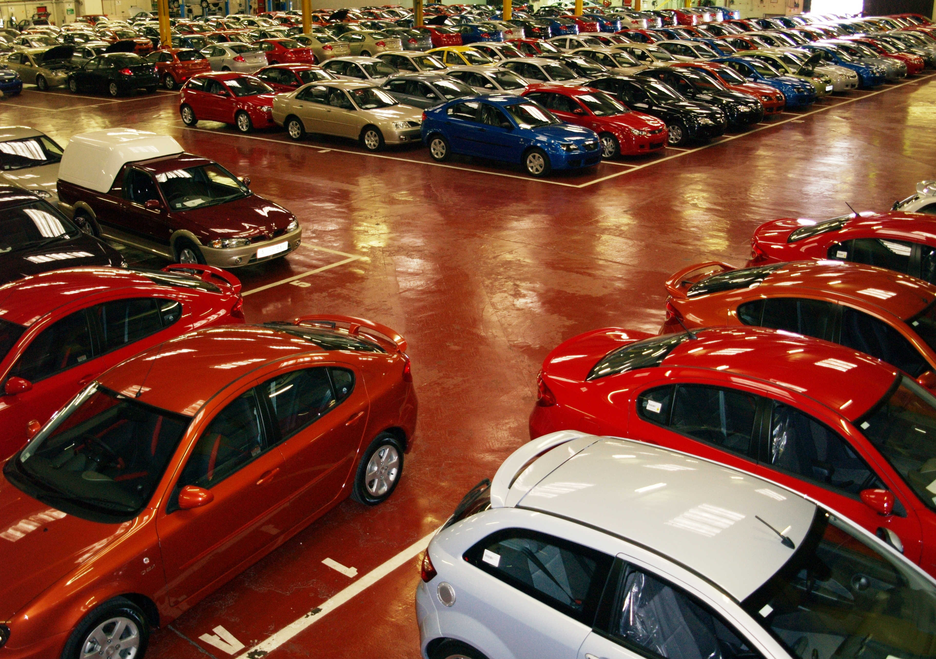
Project Background/Information (3-5 slides)

Slide 9
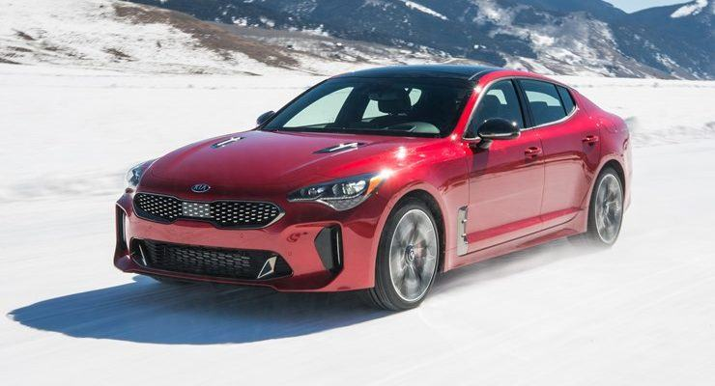
This Photo by Unknown Author is licensed under CC BY-NC

Slide 13
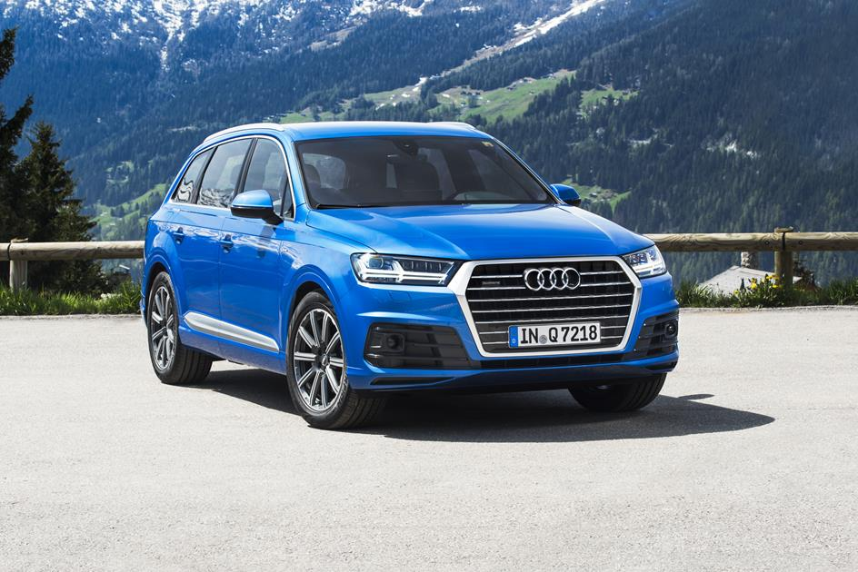
Methods
This Photo by Unknown Author is licensed under CC BY-NC-ND

Slide 14
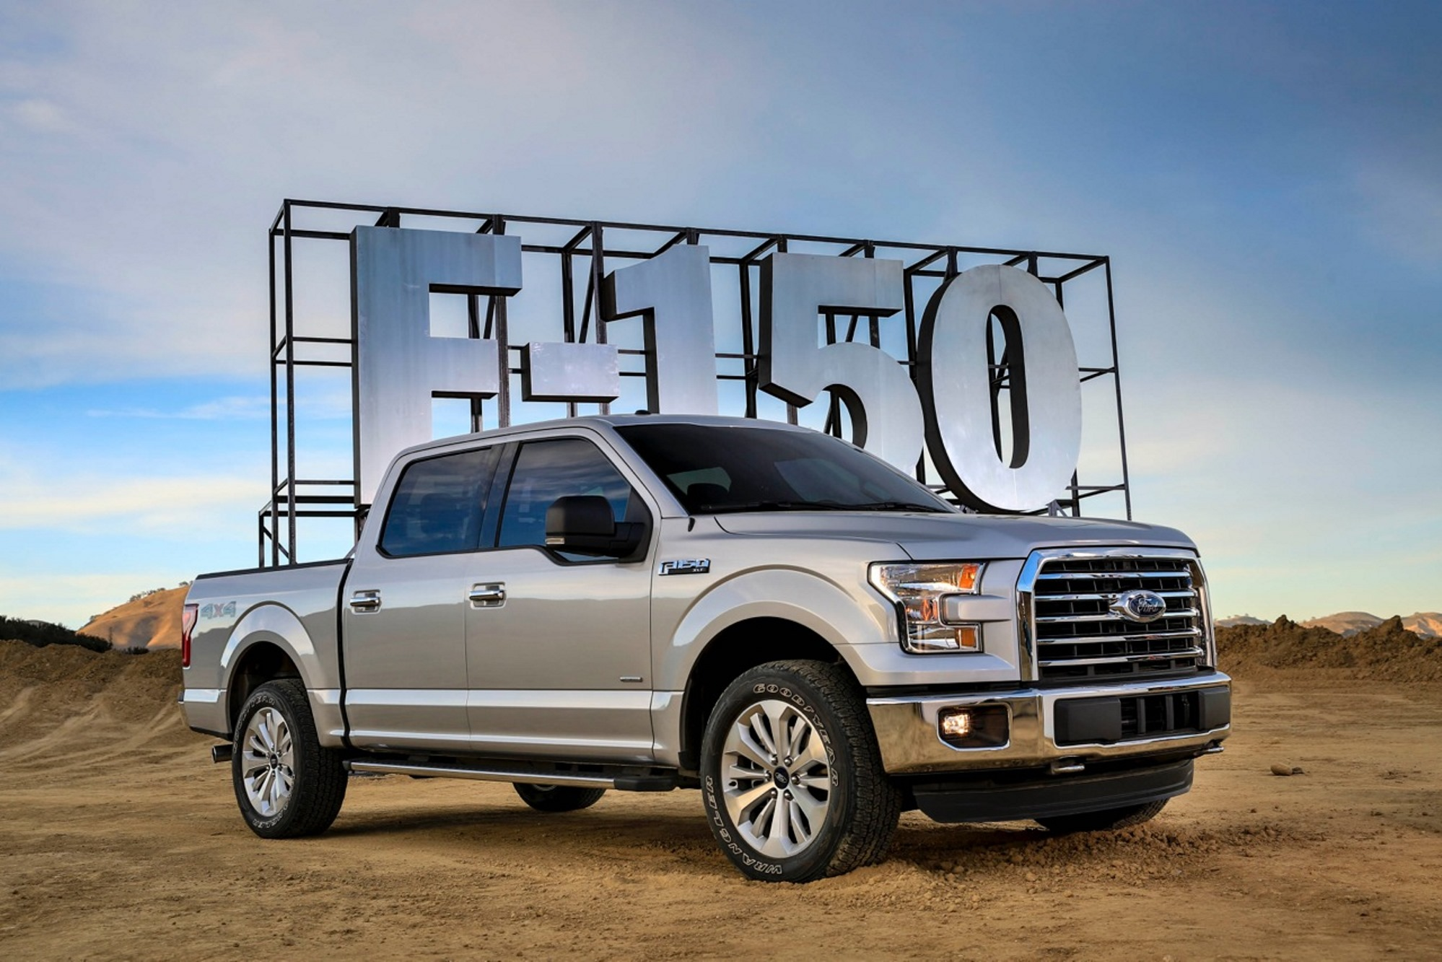
Results
Visualizations here
No code here
This Photo by Unknown Author is licensed under CC BY-NC

Slide 15
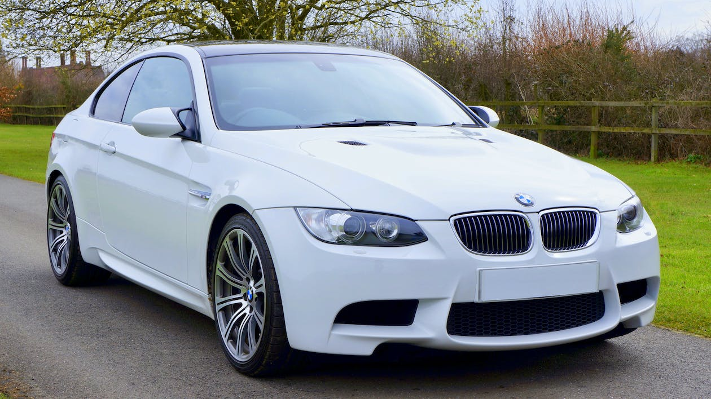
Summary (1 slide only)

Slide 16
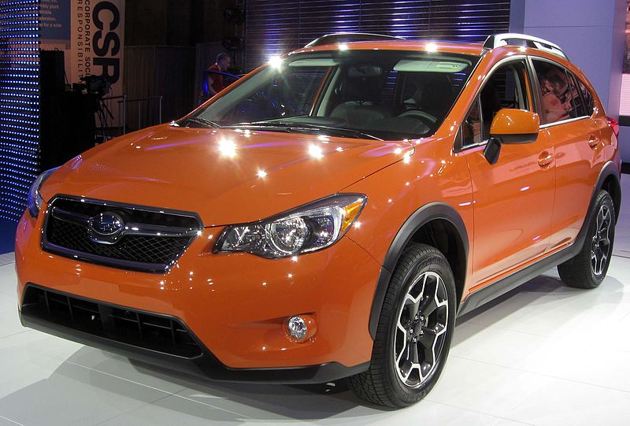
Conclusion(1 slide only)
This Photo by Unknown Author is licensed under CC BY-SA

Slide 17

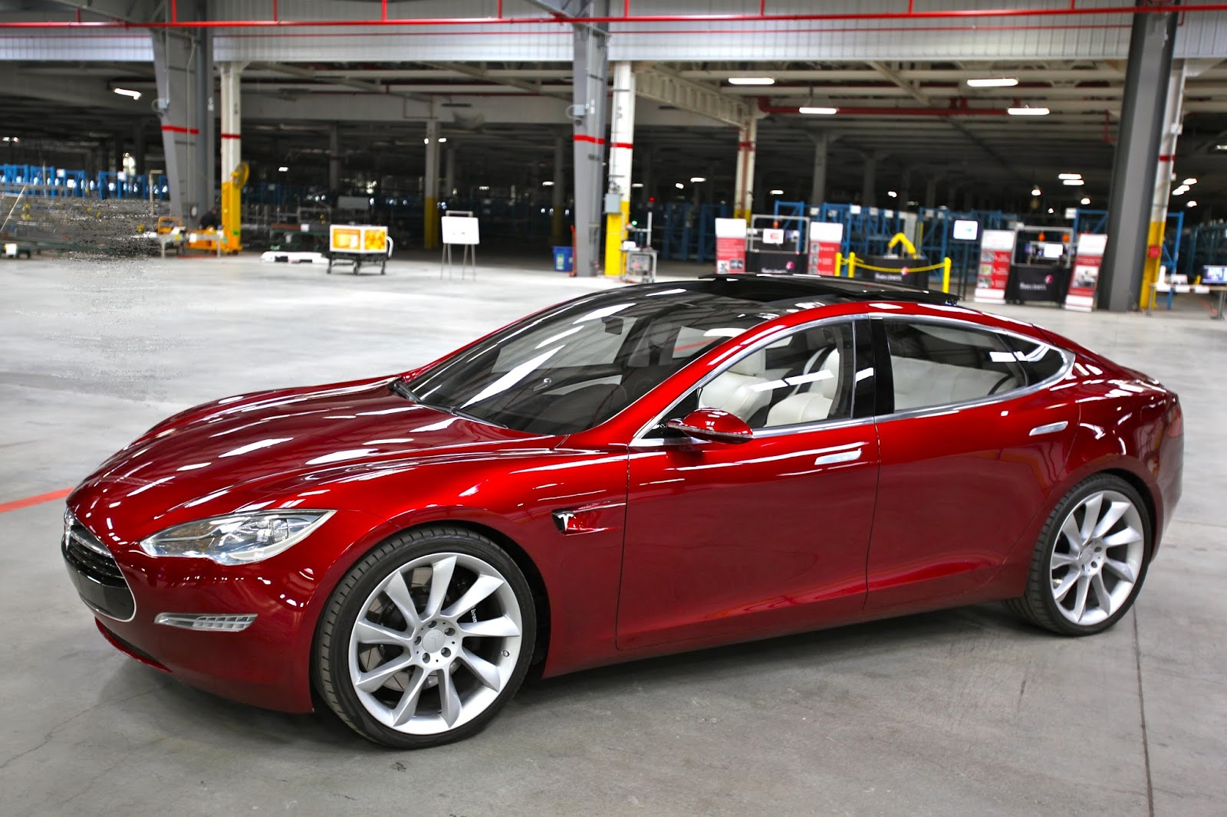
Questions???
This Photo by Unknown Author is licensed under CC BY-SA-NC
This Photo by Unknown Author is licensed under CC BY-NC

